Slide 1
Multiple Linear Regression
Multivariate, Parametric Regression Technique

Slide 2
Assumptions of a Linear Regression
Linearity The relationship between the independent and dependent variables to be linear. It is also important to check for outliers since linear regression is sensitive to outlier effects. The linearity assumption can best be tested with scatter plots
Homoscedasticity Variance in Error should be uniform, meaning the residuals are equal across the regression line.
Multivariate Normality Features should be normally distributed. Normality can be checked with a goodness of fit test, e.g., the Kolmogorov-Smirnov test. When the data is not normally distributed a non-linear transformation (e.g., log-transformation) might fix this issue.
Lack of Multicollinearity Features should not have correlations. Multicollinearity occurs when the independent variables are too highly correlated with each other.
Independence of Errors The errors should not be depend on one another. This usually occurs in time series models where the next instant is dependent on previous instant. If the error terms are correlated, the estimated standard errors tend to underestimate the true standard error.
Further Reading: http://www.statisticssolutions.com/assumptions-of-linear-regression/

Slide 3
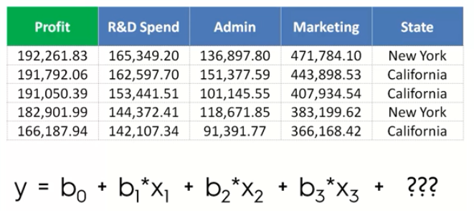
Lets talk about Categorical Variables

Slide 4
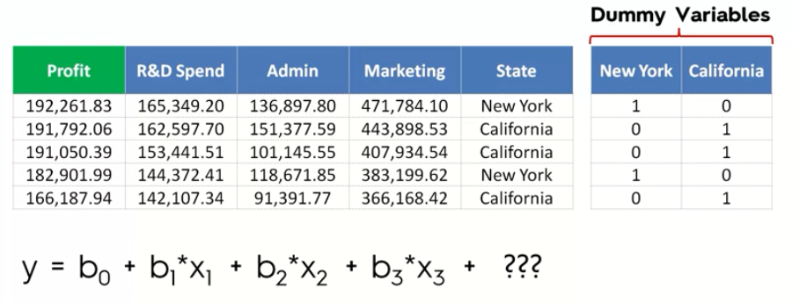
Dummy Variables

Slide 5
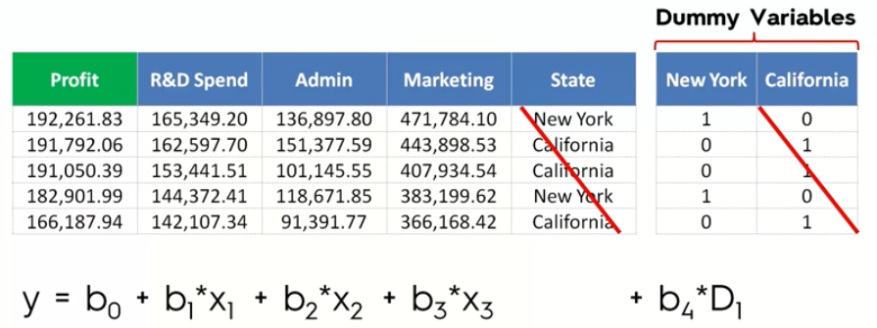
Dummy Variable Trap Something to remember about the Dummy Variables

Slide 6
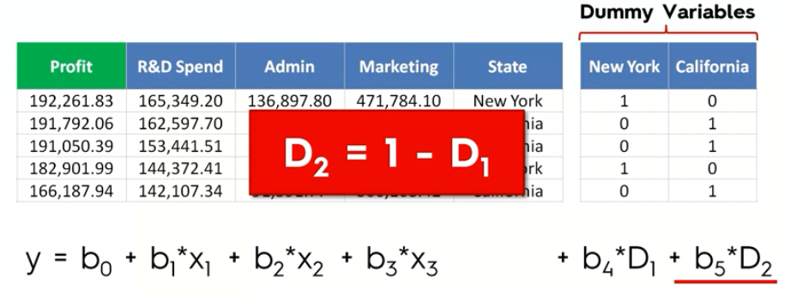
Dummy Variable Trap (Explanation)
Since the features D1 and D2 are defined as D2 = 1 - D1, this indicates correlation between the features. In the previous slides, we saw that Multicollinearity should be avoided, hence we will omit one of the dummy variables and then build the regression models.
For example, if there are n different values in a categorical feature/column, we need to convert them into n Dummy Variables, but we will only use (n-1) Dummy Variables in our regression model.

Slide 7

P-Values
A small p-value indicates that by pure luck alone, it would be highly unlikely to get a sample like the one we have - if the null hypothesis is true. If the p-value is small enough we start thinking that maybe we aren’t super lucky and instead our assumption about the Null Hypothesis being true is wrong. That’s why we reject the Null Hypothesis with a small p-value.
A large p-value indicates that it would be pretty normal to get a sample like ours if the Null Hypothesis is true. So you can see, there is no reason here to change our minds like we did with a small p-value.
Video Explanation: https://youtu.be/eyknGvncKLw

Slide 8
Presence of multiple Independent Variables
Presence of several Independent Variables can cause issues with the model, and we need to be aware about the pitfalls of using too many variables.
Garbage In Garbage Out If the independent variable(s) does not have any significant relationship with the outcome, its of no use and should be removed from our training data.
Model Complexity Presence of too many Independent Variables can make a model extremely complex and computationally expensive. Such models may not be able to make predictions in the real time.

Slide 9

Ways to build a Multi-Linear Regression Model
All In
Backward Elimination
Forward Selection
Bidirectional Elimination
Score Comparison
Stepwise Regression

Slide 10
Backward Elimination
STEP 1 Select a significance level to stay in the model (e.g. SL = 0.05)
STEP 2 Fit the full model with all possible predicators
STEP 3 Consider the predictor with the highest p-value. If p-value > SL, go to STEP 4, otherwise go to STOP.
STEP 4 Remove the predictor
STEP 5 Fit the model without this variable. Go to STEP 3
STOP Model is ready

Slide 11
Forward Selection
STEP 1 Select a significance level to enter the model (e.g. SL = 0.05)
STEP 2 Fit all Simple Linear Regression models for each variable. Select the one with the lowest p-value
STEP 3 Keep this variable and fit all possible models with one extra predicator added to the one(s) you already have
STEP 4 Consider the predictor with the lowest p-value. If P-Value < SL, go to STEP 3, otherwise go to STOP
STOP Keep the previous model.

Slide 12
Bidirectional Elimination
STEP 1 Select a significance level to enter and stay in the model.
(e.g. SL_{enter} = 0.05, SL_{stay} = 0.05)
STEP 2 Perform the next step to Forward Selection.
(new variables must have P-value < SL_{enter} to enter.)
STEP 3 Perform ALL the steps of Backward Elimination.
(old variables must have P < SL_{stay})
STEP 4 No new variables can enter and no existing variables can leave the model.
STOP Model is ready.

Slide 13
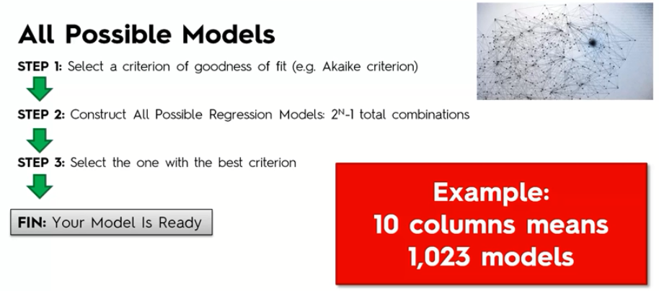
Score Comparison

